Slide 1
Plotting with ggplot2 in R

Slide 2
Content
Produce scatter plots, boxplots, and time series plots using ggplot.
Set universal plot settings.
Describe what faceting is and apply faceting in ggplot.
Modify the aesthetics of an existing ggplot plot (including axis labels and colour).
Build complex and customized plots from data in a data frame.

Slide 3
Get the data
Download package with our data in
devtools::install_github("n8thangreen/dataPakistan")
Load the package with the data in
library(dataPakistan)
Take a look at what data is available
system.file("extdata", package = "dataPakistan")

Slide 4
Import data
Using one of the ways already mentioned e.g.
Use Environment|Import Dataset pane
Import
Admin-datasheet-year2018.xlsx
Or type in the console
> library(readxl)
> dat <- read_excel("C:/Users/ngreen1/Documents/R/win-library/3.6/dataPakistan/extdata/Admin-datasheet-year2018.xlsx")
> View(dat)

Slide 5
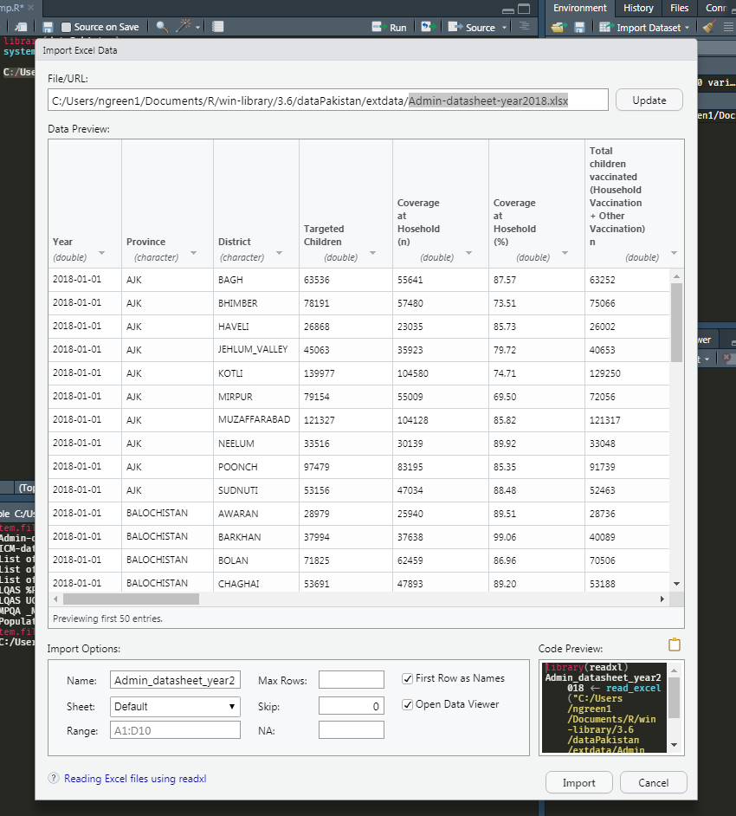

Slide 6
What is ggplot?
ggplot2 is a plotting package that makes it simple to create complex plots from data in a data frame
Provides a more programmatic interface for specifying what variables to plot, how they are displayed, and general visual properties
Only need minimal changes if the underlying data change or if we decide to change from a bar plot to a scatter plot
Helps in creating publication quality plots with minimal amounts of adjustments and tweaking.
ggplot2 functions like data in the ‘long’ format
i.e., a column for every dimension, and a row for every observation. Well-structured data will save you lots of time when making figures with ggplot2

Slide 7
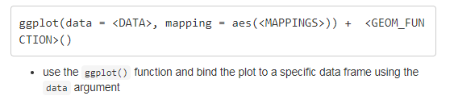
ggplot graphics are built step by step by adding new elements
Adding layers in this fashion allows for extensive flexibility and customization of plots.
To build a ggplot, we will use the following basic template that can be used for different types of plots:

Slide 8
aes
Define a mapping (using the aesthetic (aes) function), by selecting the variables to be plotted and specifying how to present them in the graph
e.g. as x/y positions or characteristics such as size, shape, colour, etc.

Slide 9

geoms
add ‘geoms’
graphical representations of the data in the plot (points, lines, bars)
ggplot2 offers many different geoms; we will use some common ones today, including:

Slide 10
+ operator
To add a geom to the plot use the + operator
Because we have two continuous variables, let’s use geom_point() first:

Slide 11
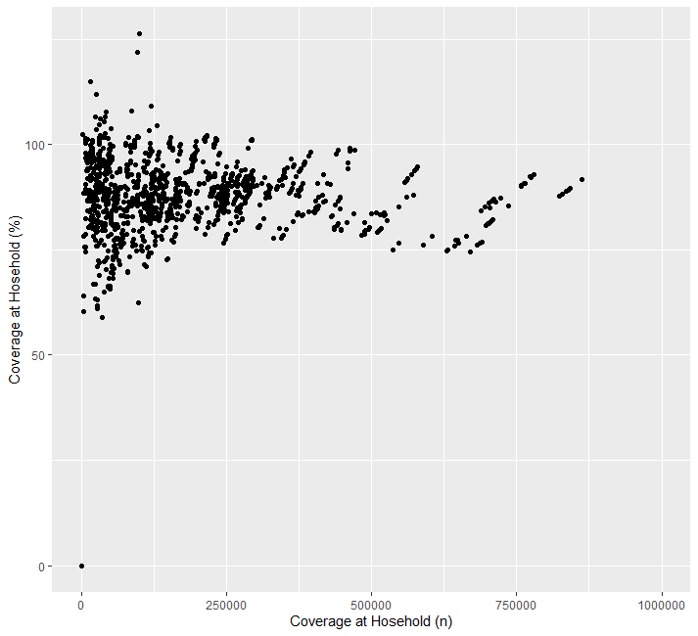

Slide 12
The + in the ggplot2 package is particularly useful because it allows you to modify existing ggplot objects.
This means you can easily set up plot templates and conveniently explore different types of plots, so the above plot can also be generated with code like this:
my_plot <- ggplot(data = dat, mapping = aes(x = `Coverage at Hosehold (n)`, y = `Coverage at Hosehold (%)`))
my_plot + geom_point() + xlim(0, 1e+6)

Slide 13
Notes
Anything you put in the ggplot() function can be seen by any geom layers that you add (i.e., these are universal plot settings). This includes the x- and y-axis mapping you set up in aes().
You can also specify mappings for a given geom independently of the mappings defined globally in the ggplot() function.
The + sign used to add new layers must be placed at the end of the line containing the previous layer. If, instead, the + sign is added at the beginning of the line containing the new layer, ggplot2 will not add the new layer and will return an error message.

Slide 14
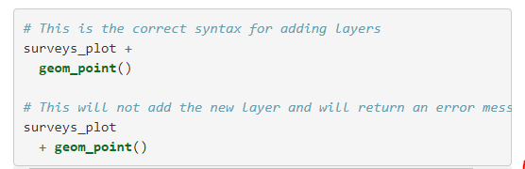

Slide 15

hexbin
Scatter plots can be useful exploratory tools for small datasets. For data sets with large numbers of observations,overplotting of points can be a limitation of scatter plots. One strategy for handling such settings is to use hexagonal binning of observations. The plot space is tessellated into hexagons. Each hexagon is assigned a colour based on the number of observations that fall within its boundaries. To use hexagonal binning with ggplot2, first install the R package hexbin from CRAN:

Slide 16
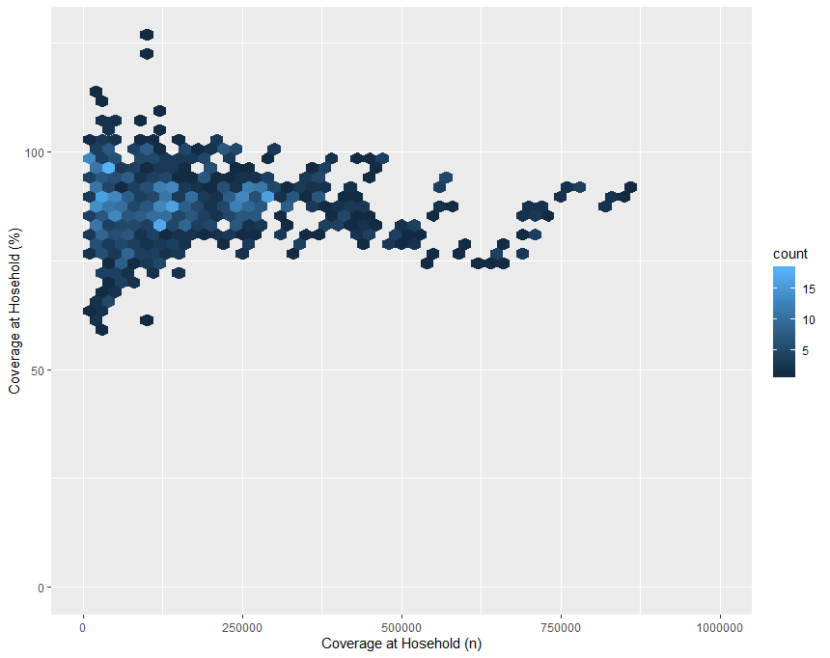

Slide 17
Building plots iteratively
Building plots with ggplot2 is typically an iterative process. We start by defining the dataset we’ll use, lay out the axes, and choose a geom.
Then, we start modifying this plot to extract more information from it. For instance, we can add transparency (alpha) to avoid overplotting:

Slide 18
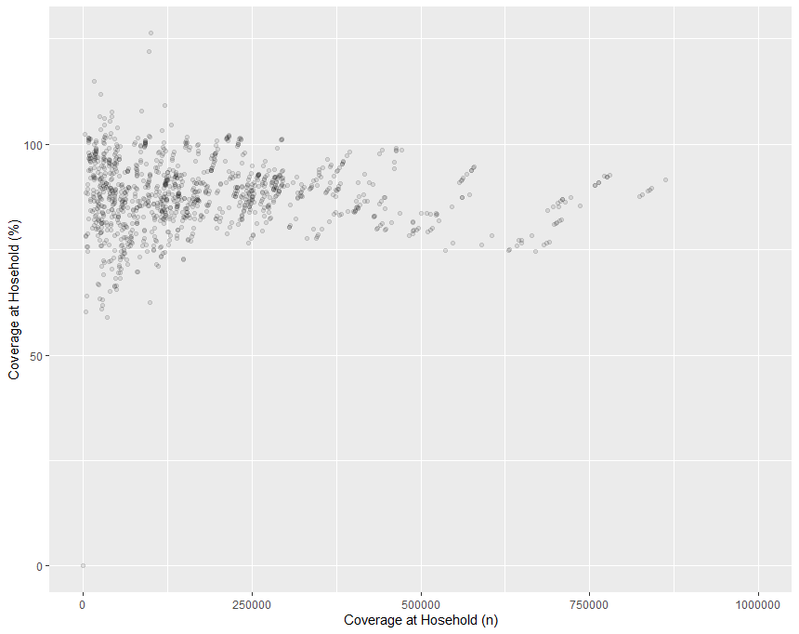

Slide 19
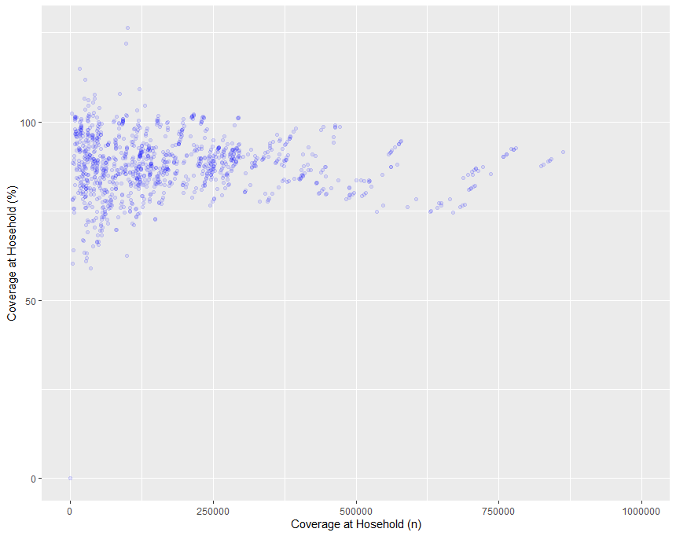
Colours
We can also add colours for all the points:

Slide 20
Or to colour each species in the plot differently, you could use a vector as an input to the argument colour.
ggplot2 will provide a different colour corresponding to different values in the vector.
Here is an example where we colour with Province:

Slide 21
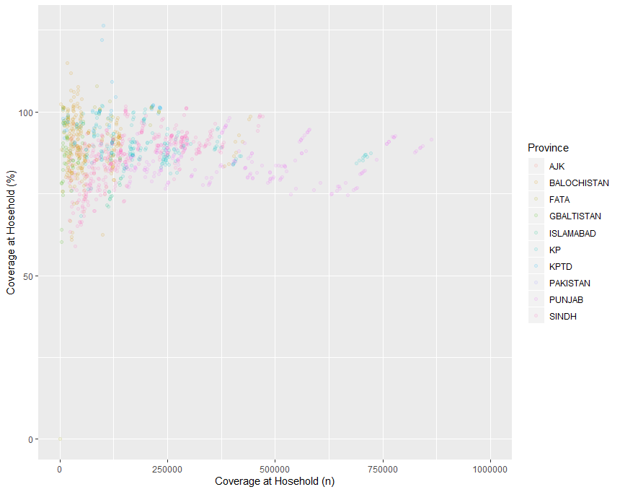

Slide 22
We can also specify the colors directly inside the mapping provided in the ggplot() function.
This will be seen by any geom layers and the mapping will be determined by the x- and y-axis set up in aes().

Slide 23
Your turn
Use what you just learned to create a scatter plot of Coverage at household (n) by Province with the Year showing in different colours.
Is this a good way to show this type of data?

Slide 24


Slide 25
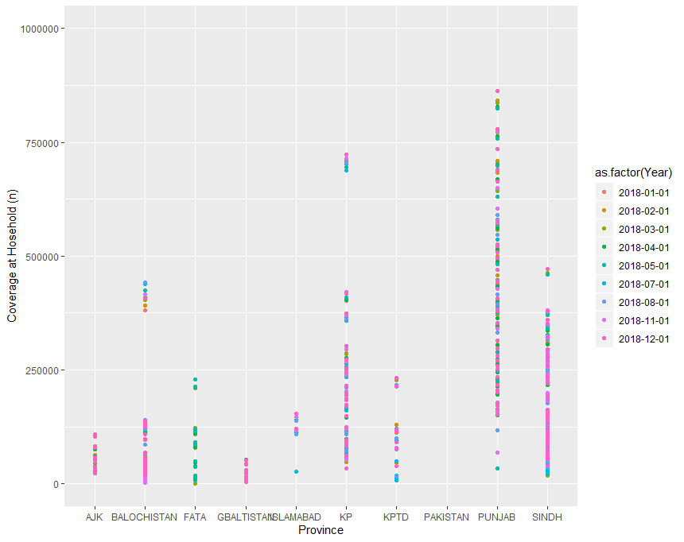

Slide 26

Boxplot
Visualise distribution with geom_boxplot()

Slide 27
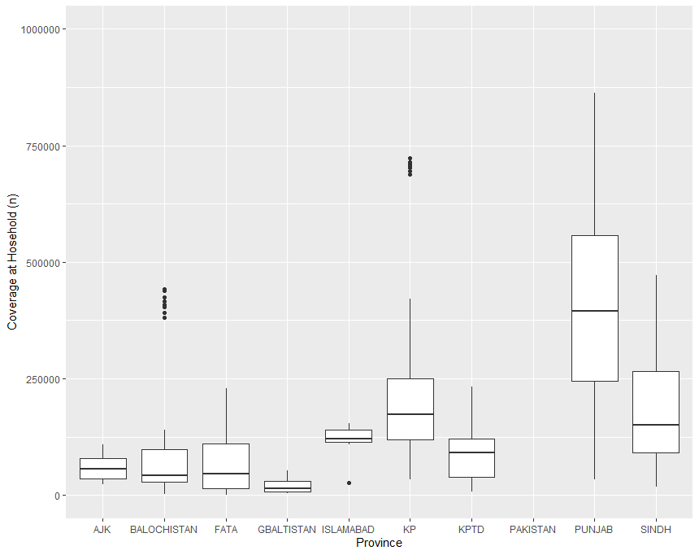

Slide 28

By adding points to boxplot, we can have a better idea of the number of measurements and of their distribution:

Slide 29
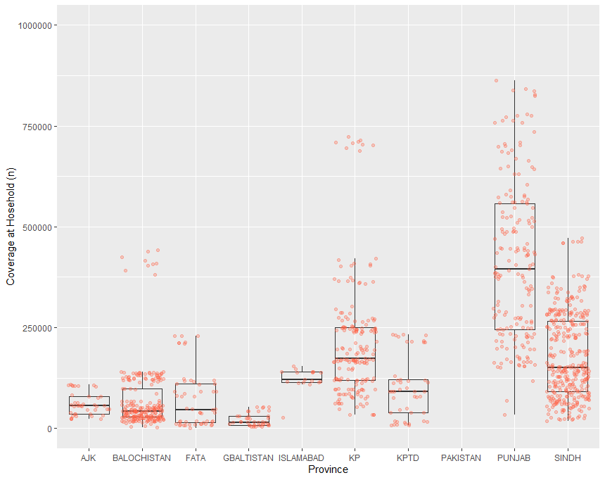

Slide 30
Notice how the boxplot layer is behind the jitter layer?
What do you need to change in the code to put the boxplot in front of the points such that it’s not hidden?

Slide 31


Slide 32
Your turn
Boxplots are useful summaries, but hide the shape of the distribution. For example, if the distribution is bimodal, we would not see it in a boxplot. An alternative to the boxplot is the violin plot, where the shape (of the density of points) is drawn.
Replace the box plot with a violin plot; see geom_violin().
In many types of data, it is important to consider the scale of the observations. For example, it may be worth changing the scale of the axis to better distribute the observations in the space of the plot. Changing the scale of the axes is done similarly to adding/modifying other components (i.e., by incrementally adding commands). Try making these modifications:
Represent weight on the log10 scale; see scale_y_log10().
So far, we’ve looked at the distribution of xxx within species. Try making a new plot to explore the distribution of another variable within each species.
Create a boxplot for xxx. Overlay the boxplot layer on a jitter layer to show actual measurements.
Add colour to the data points on your boxplot according to the plot from which the sample was taken (Year).
Hint: Check the class for Year. Consider changing the class of Year from integer to factor. Why does this change how R makes the graph?

Slide 33
Plotting time series data
Let’s visualise the number of coverage per household per year for each District as line plot

Slide 34
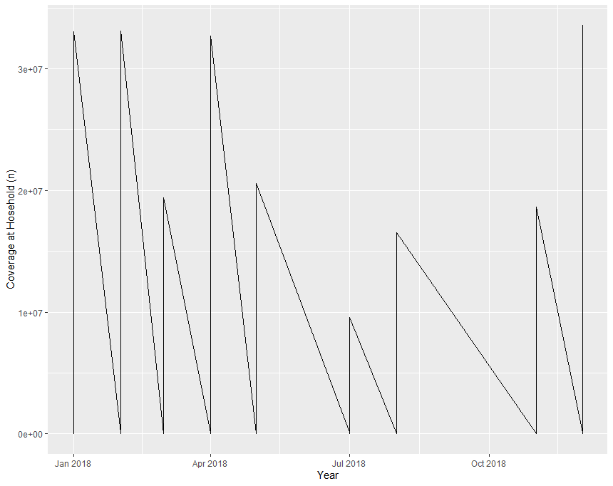

Slide 35
Unfortunately, this does not work because we plotted data for all the Districts together.
We need to tell ggplot to draw a line for each by modifying the aesthetic function to include group = District:

Slide 36
We will be able to distinguish District in the plot if we add colours (using colour also automatically groups the data):

Slide 37
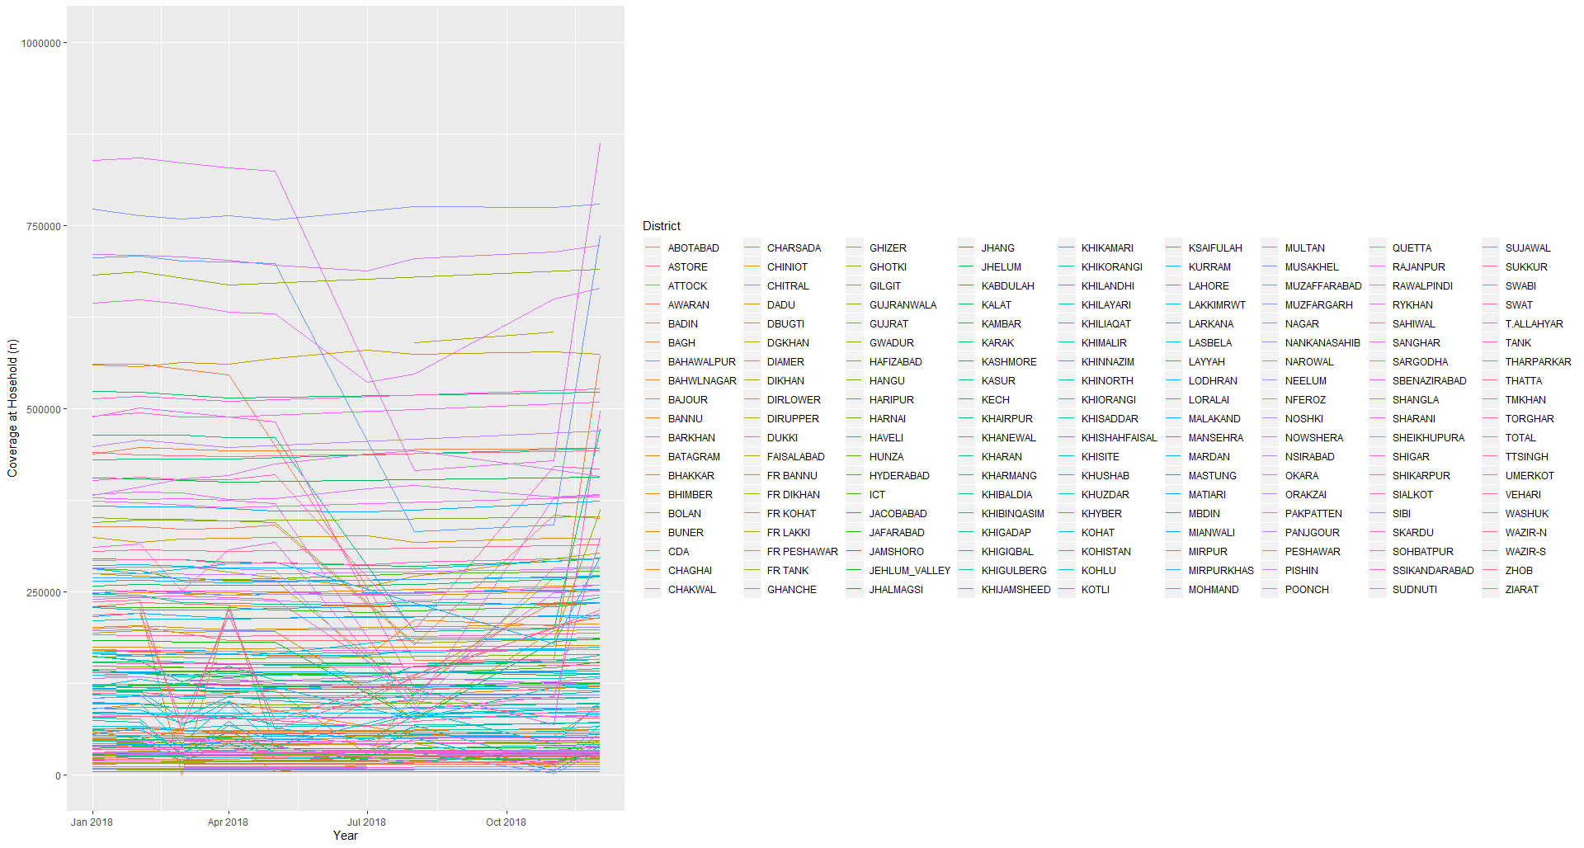

Slide 38
Both geometries allow to to specify faceting variables specified within vars().
Eg
facet_wrap(facets = vars(facet_variable)) or facet_grid(rows = vars(row_variable), cols = vars(col_variable)).
Let’s start by using facet_wrap() to make a time series plot for a subset of Districts:

Slide 39
Faceting
ggplot2 has a special technique called faceting that allows the user to split one plot into multiple plots based on a factor included in the dataset.
There are two types of facet functions:
facet_wrap() arranges a one-dimensional sequence of panels to allow them to cleanly fit on one page.
facet_grid() allows you to form a matrix of rows and columns of panels.

Slide 40


Slide 41
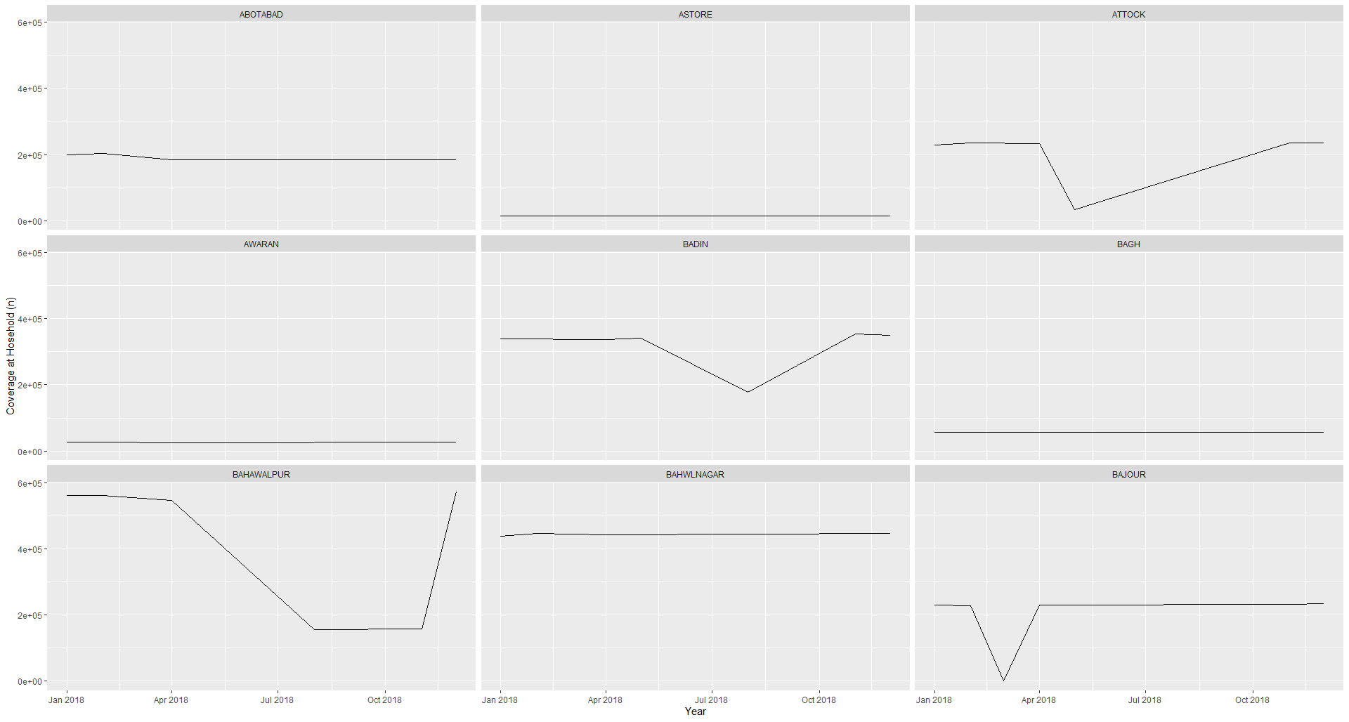

Slide 42
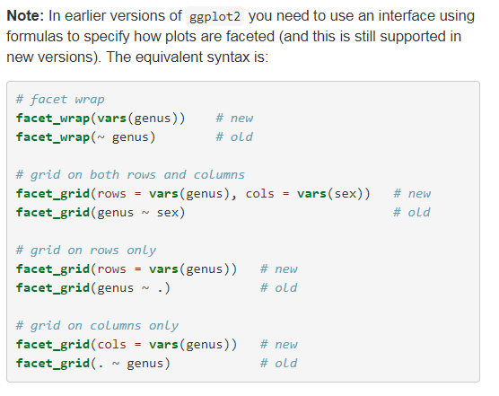

Slide 43
ggplot themes
Usually plots with white background look more readable when printed.
Every single component of a ggplot graph can be customized using the generic theme() function, as we will see below.
However, there are pre-loaded themes available that change the overall appearance of the graph without much effort.
Eg
we can change our previous graph to have a simpler white background using the theme_bw() function:

Slide 44
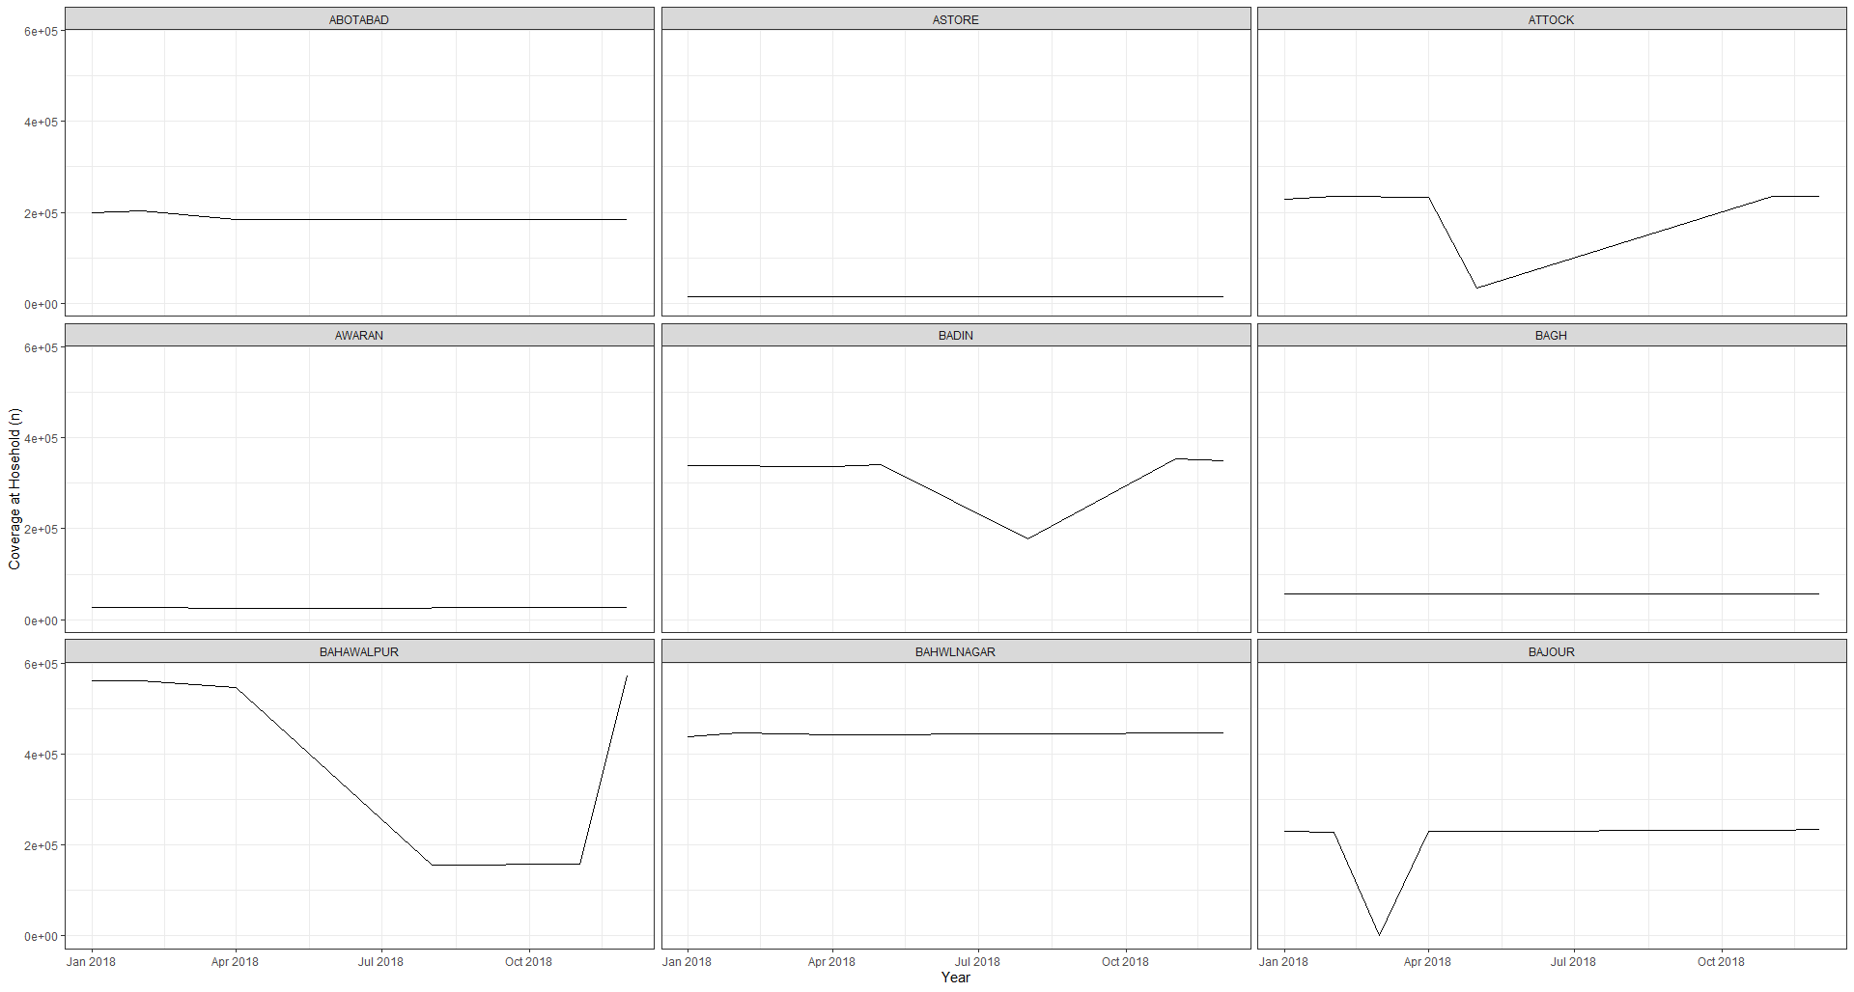

Slide 46
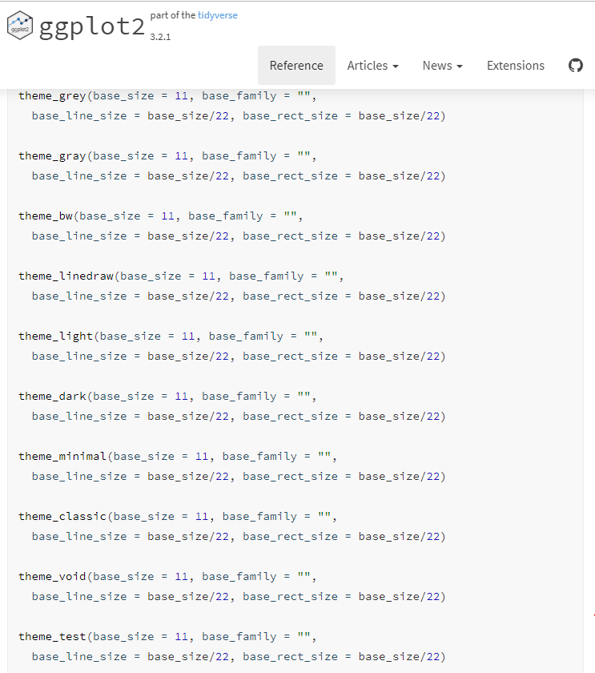

Slide 47
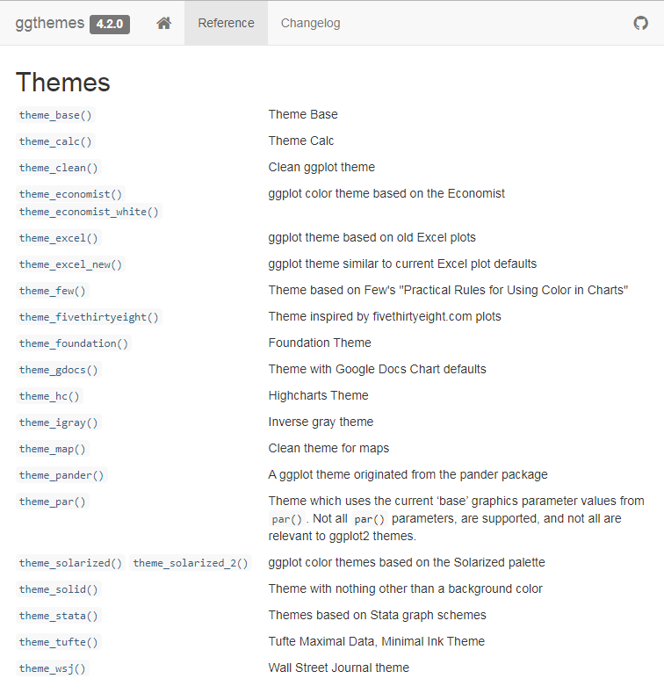

Slide 48
Arranging and exporting plots
Faceting is a great tool for splitting one plot into multiple plots, but sometimes you may want to produce a single figure that contains multiple plots using different variables or even different data frames. The gridExtra package allows us to combine separate ggplots into a single figure using grid.arrange():

Slide 49
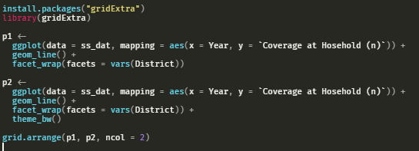

Slide 50
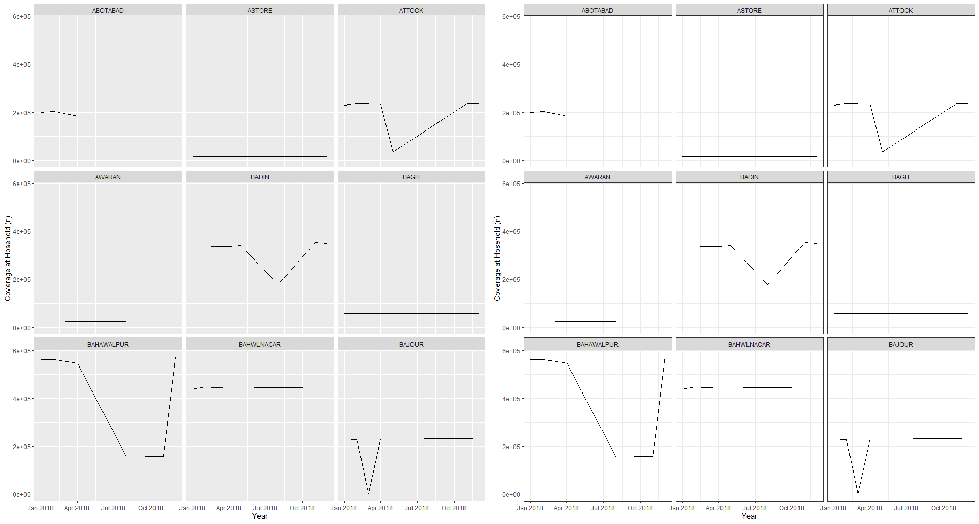

Slide 51
Saving plots
use the ggsave() function, which allows you easily change the dimension and resolution of your plot by adjusting the appropriate arguments (width, height and dpi).

